Slide 1
1 meter of elevation head
1 meter
Reference elevation
1 meter of pressure head
1 meter of velocity head

Slide 2
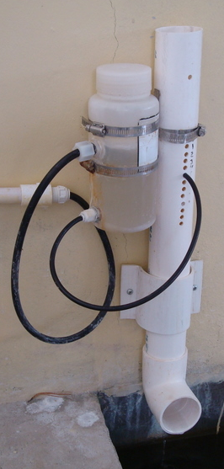
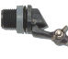
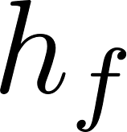
Air vent
Tube from the stock tank
Float valve
Holes to choose the dose
Flexible tube
Raw water
Rapid Mix
Orifice

Slide 3
V_{in}
V_{out}
A_{in}
x
A_{out}
in
out

Slide 4
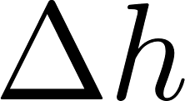
Horizontal orifice
Vertical orifice

Slide 5
Overhead Tank
Constant head orifice
Overflow pipe
Pump

Slide 6

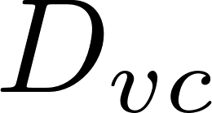
A
B

Slide 7
Pipe stub
Pipe coupling
Drain piping

Slide 8
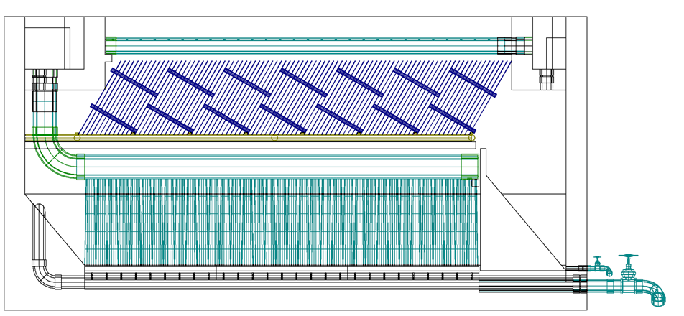
AutoCAD drawing of sedimentation tank, don’t worry if this is confusing!
You’ll learn about it in depth later on.
Sedimentation
tank drain

Slide 9
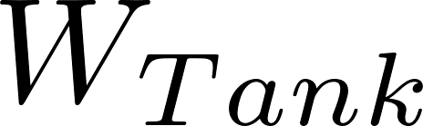
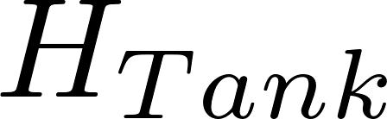
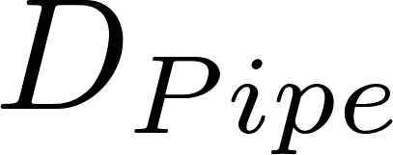
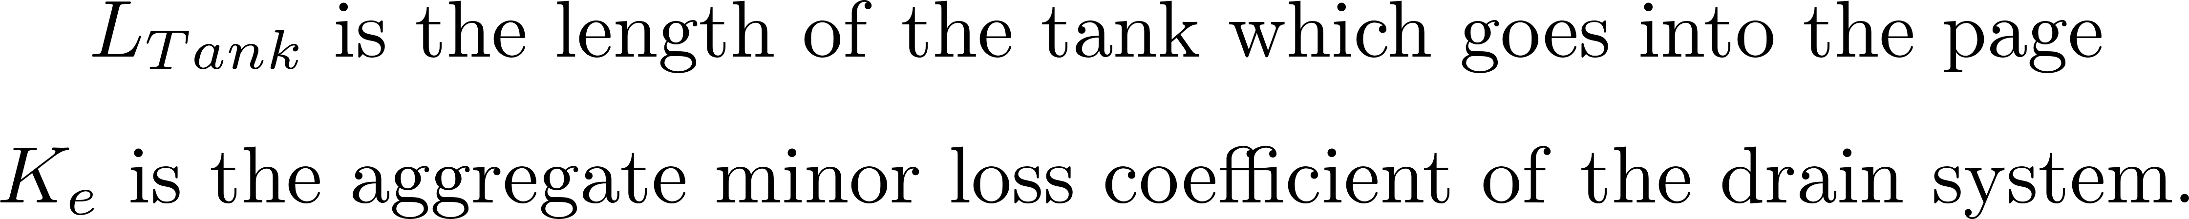

Slide 10

Float
Float
Orifice
Orifice
Transparent flexible tube
Transparent flexible tube

Slide 12
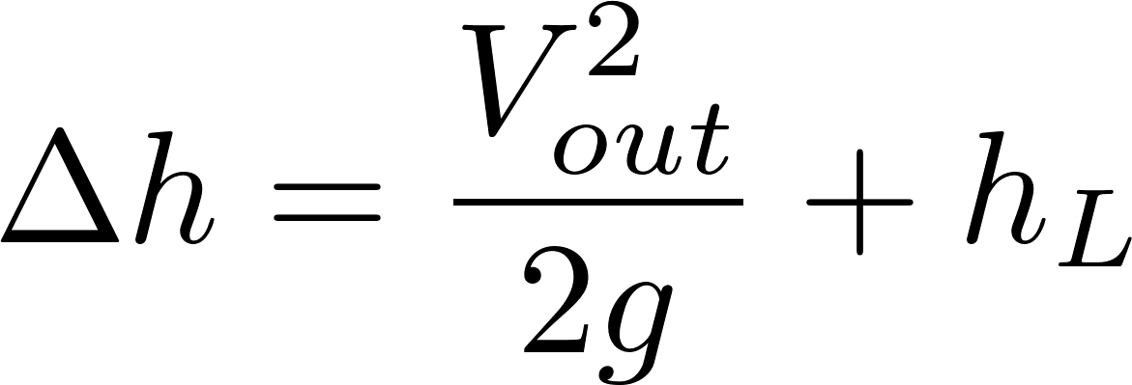
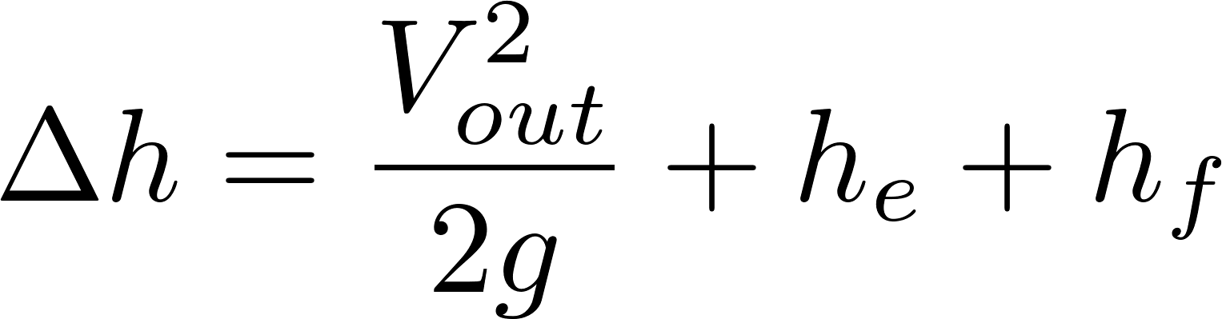
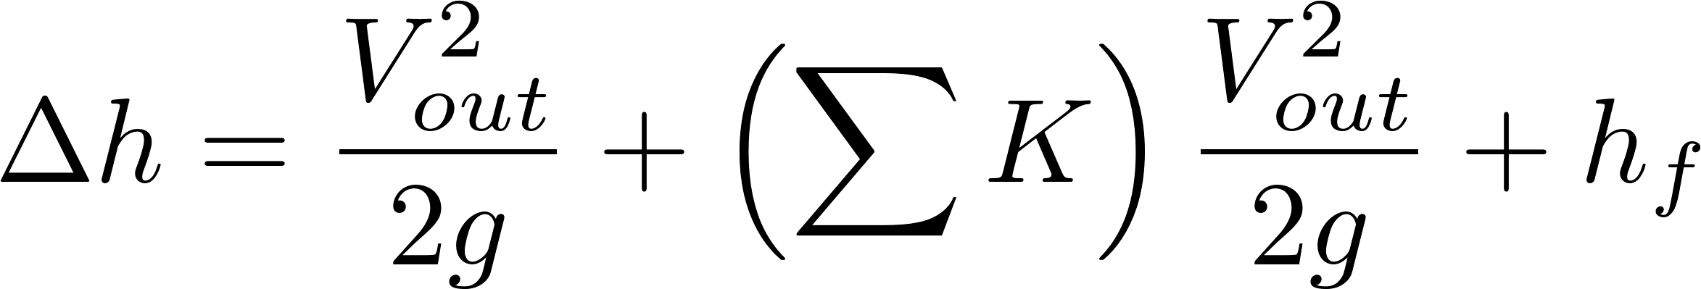
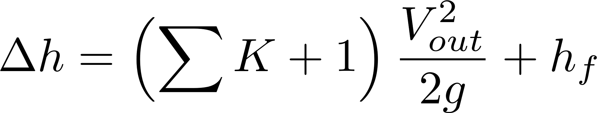
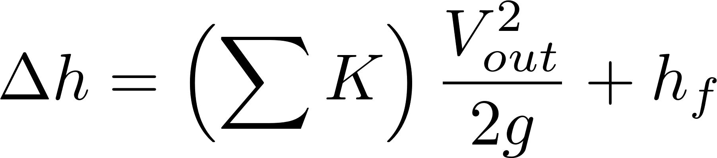
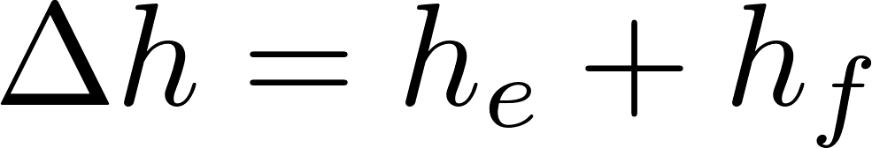

Simplified
energy equation
Just adding
K = 1 to the sum

Slide 13
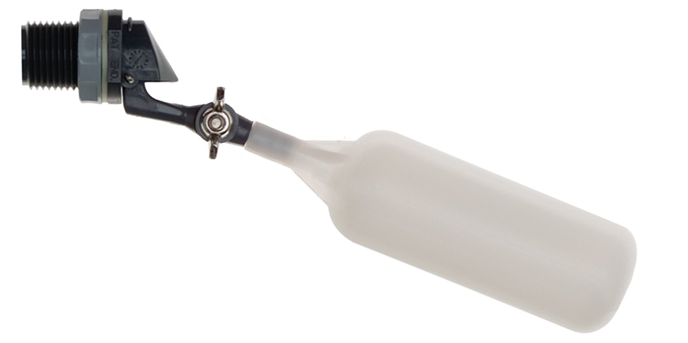
Flow of water
out of valve
Range of
motion of float
Float

Slide 14
C
B
A

Slide 15
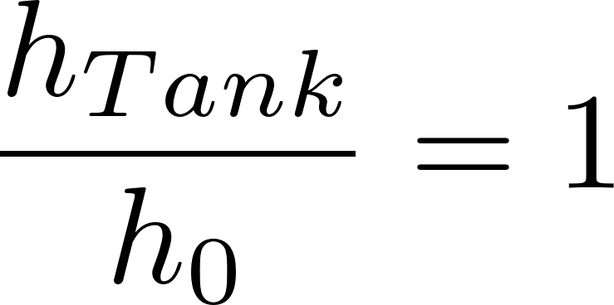
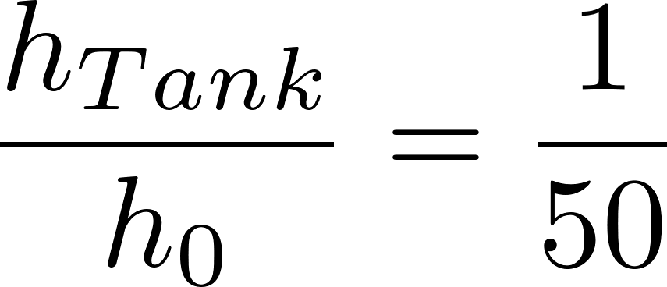
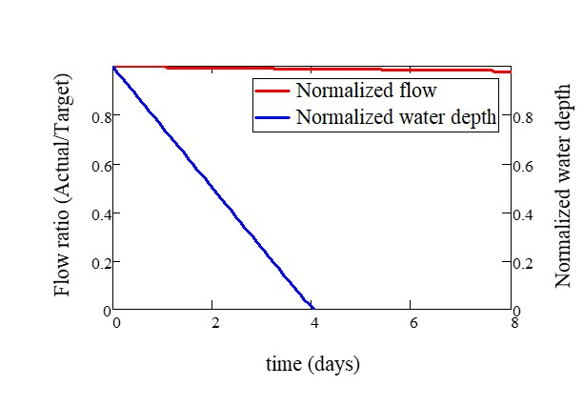
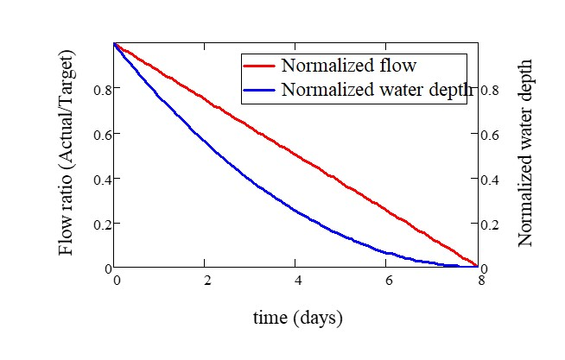

Slide 16
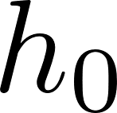
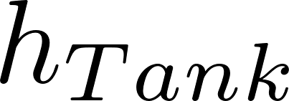
Tank
Valve
Water source pipe
Tank
Valve
Water source pipe

